Slide 1
Agenda
GAP results: related counters
DiLOS comparison

Slide 2
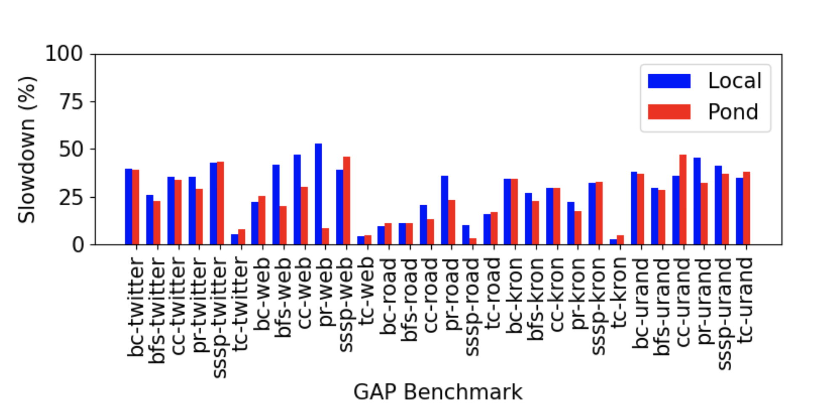
GAPBS Ours v. Pond
From Intel MLC tool
Our testbed
Local: 89 ns / 65 GBps
Remote: 153 ns / 31 GBps (171%)
Pond: 183%

Slide 3
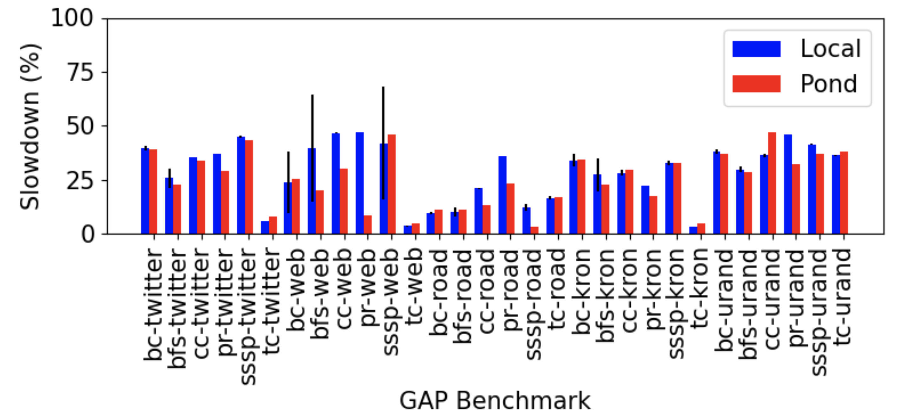
GAPBS Ours v. Pond
From Intel MLC tool
Our testbed
Local: 89 ns / 65 GBps
Remote: 153 ns / 31 GBps (171%)
Pond: 183%

Slide 4
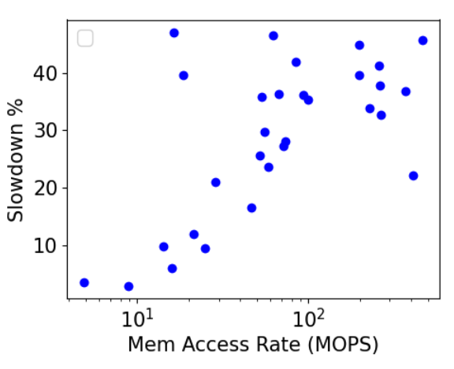
What factors can explain slowdown?
Some correlation with access rate
Other factors:
Bandwidth
Store accesses
Not many
Mean 2.4%, Max 16%
Actual stalls per load misses
No better correlation with slowdown
Stall mostly at ~90%
Memory access rate
Correlation: 0.44

Slide 5
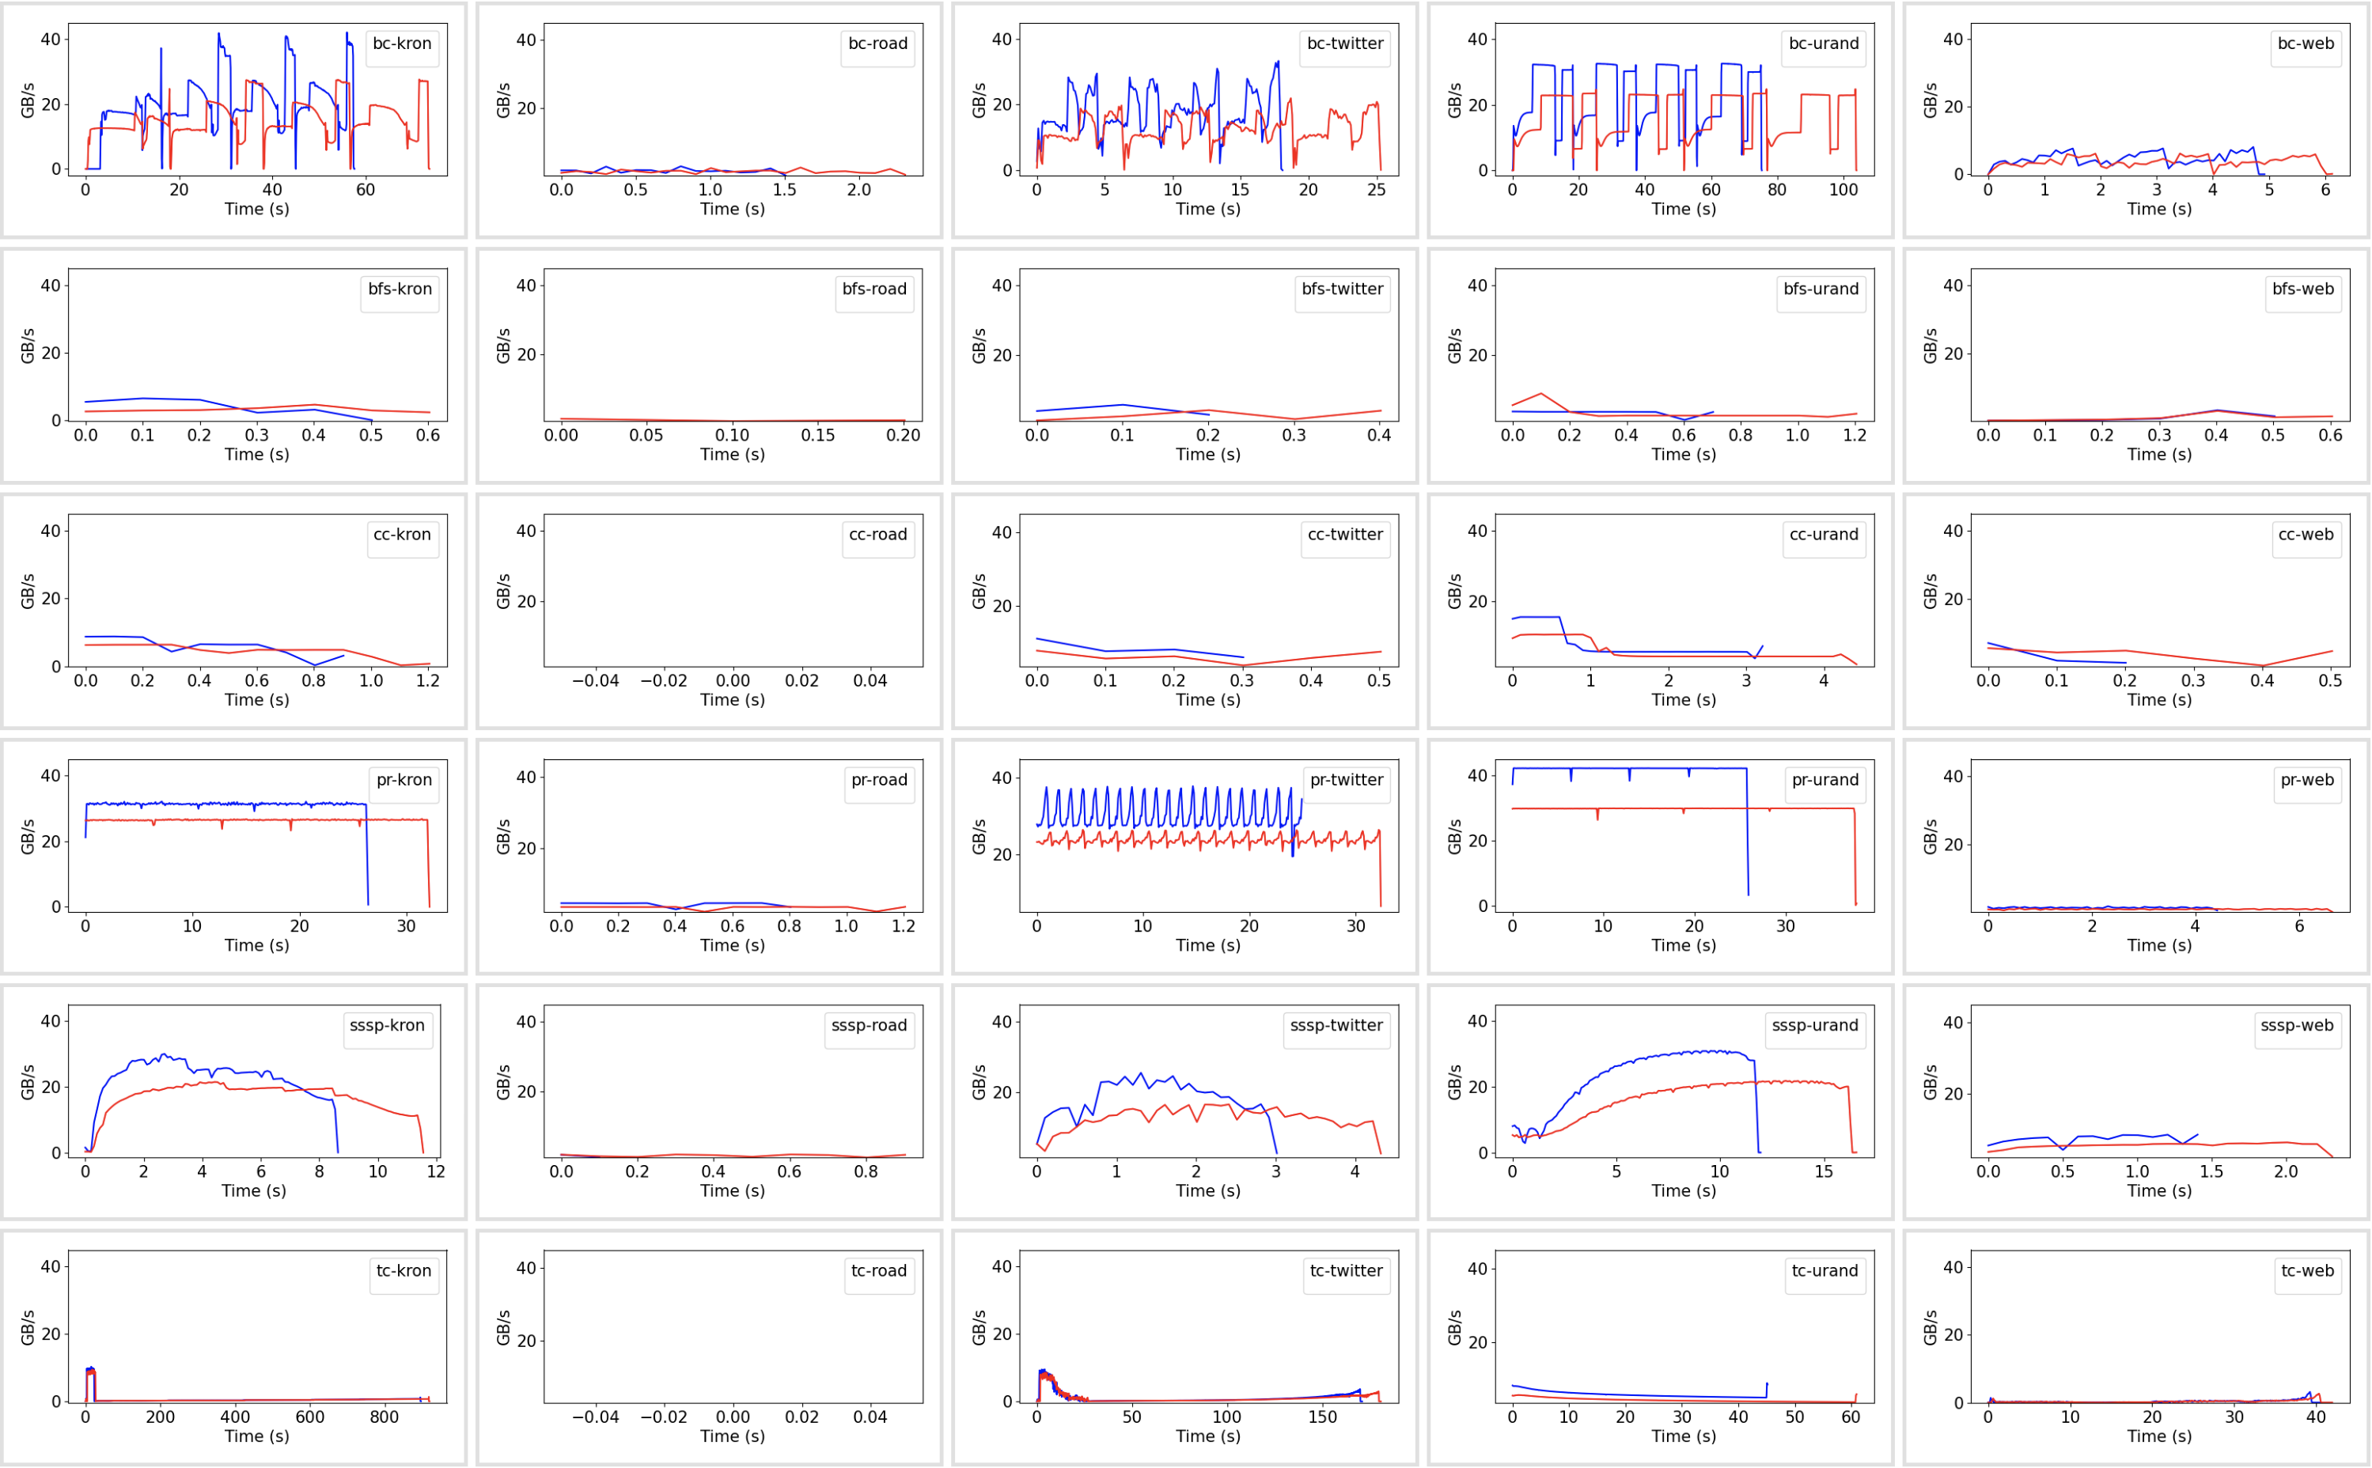
Memory Access Rate (Local vs. Remote)

Slide 6
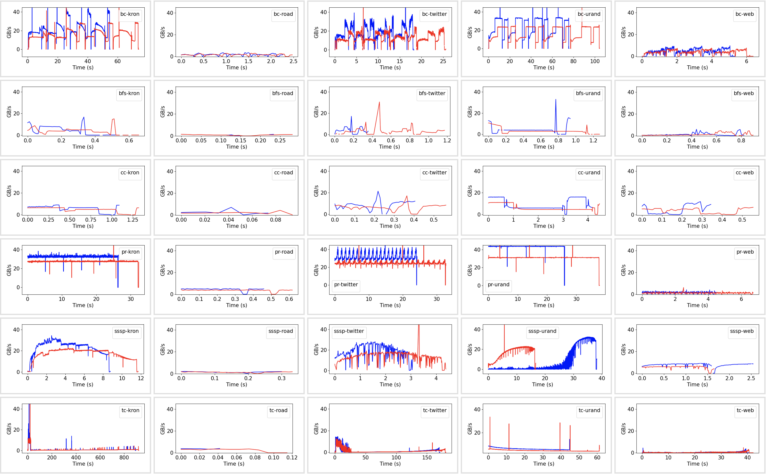
Memory Access Rate (Local vs. Remote)

Slide 7
Bandwidth control
Taking memory on specific channels offline
Memory hotplug feature provides a software option but not sure how the memory “blocks” map to DIMMs/channels
Careful analysis needed on what to offline

Slide 8
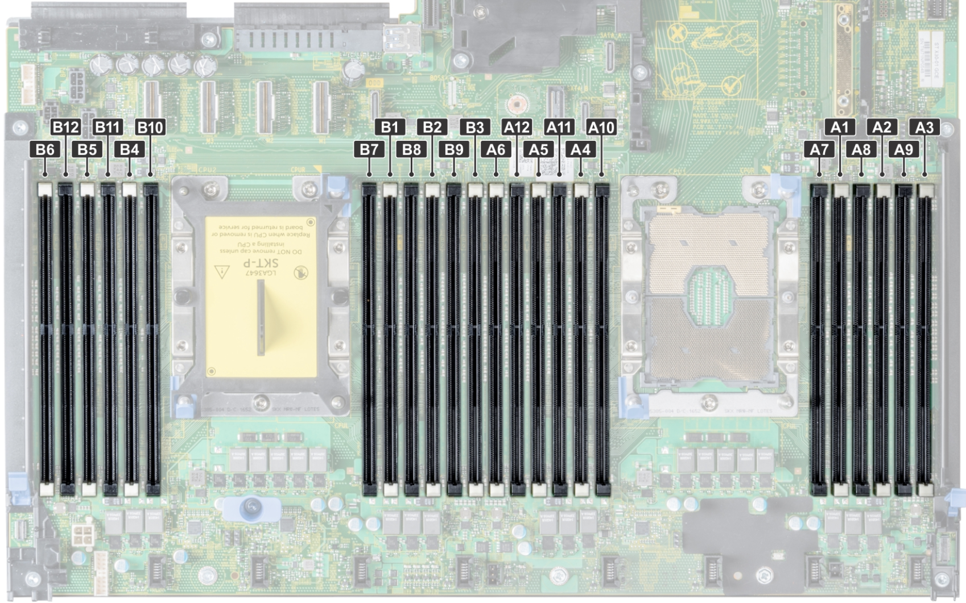
Current Memory Layout
Each node:
12 slots, 6 channels
64 GB total installed
Four 16-GB sticks

Slide 9
Next
Look more into stalls

Slide 10
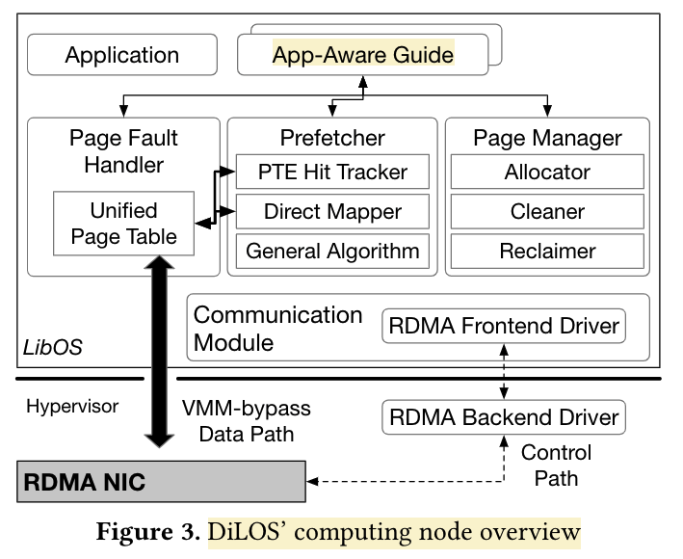
DilOS
Goal:
Reduce page fault costs with “simpler” handling
Specialized kernel
Avoiding minor page-faults on prefetch
Better hiding reclaim costs
Enable app-aware “guides” e.g., prefetching
Runs in a VM with LibOS

Slide 11
Misc

Slide 12
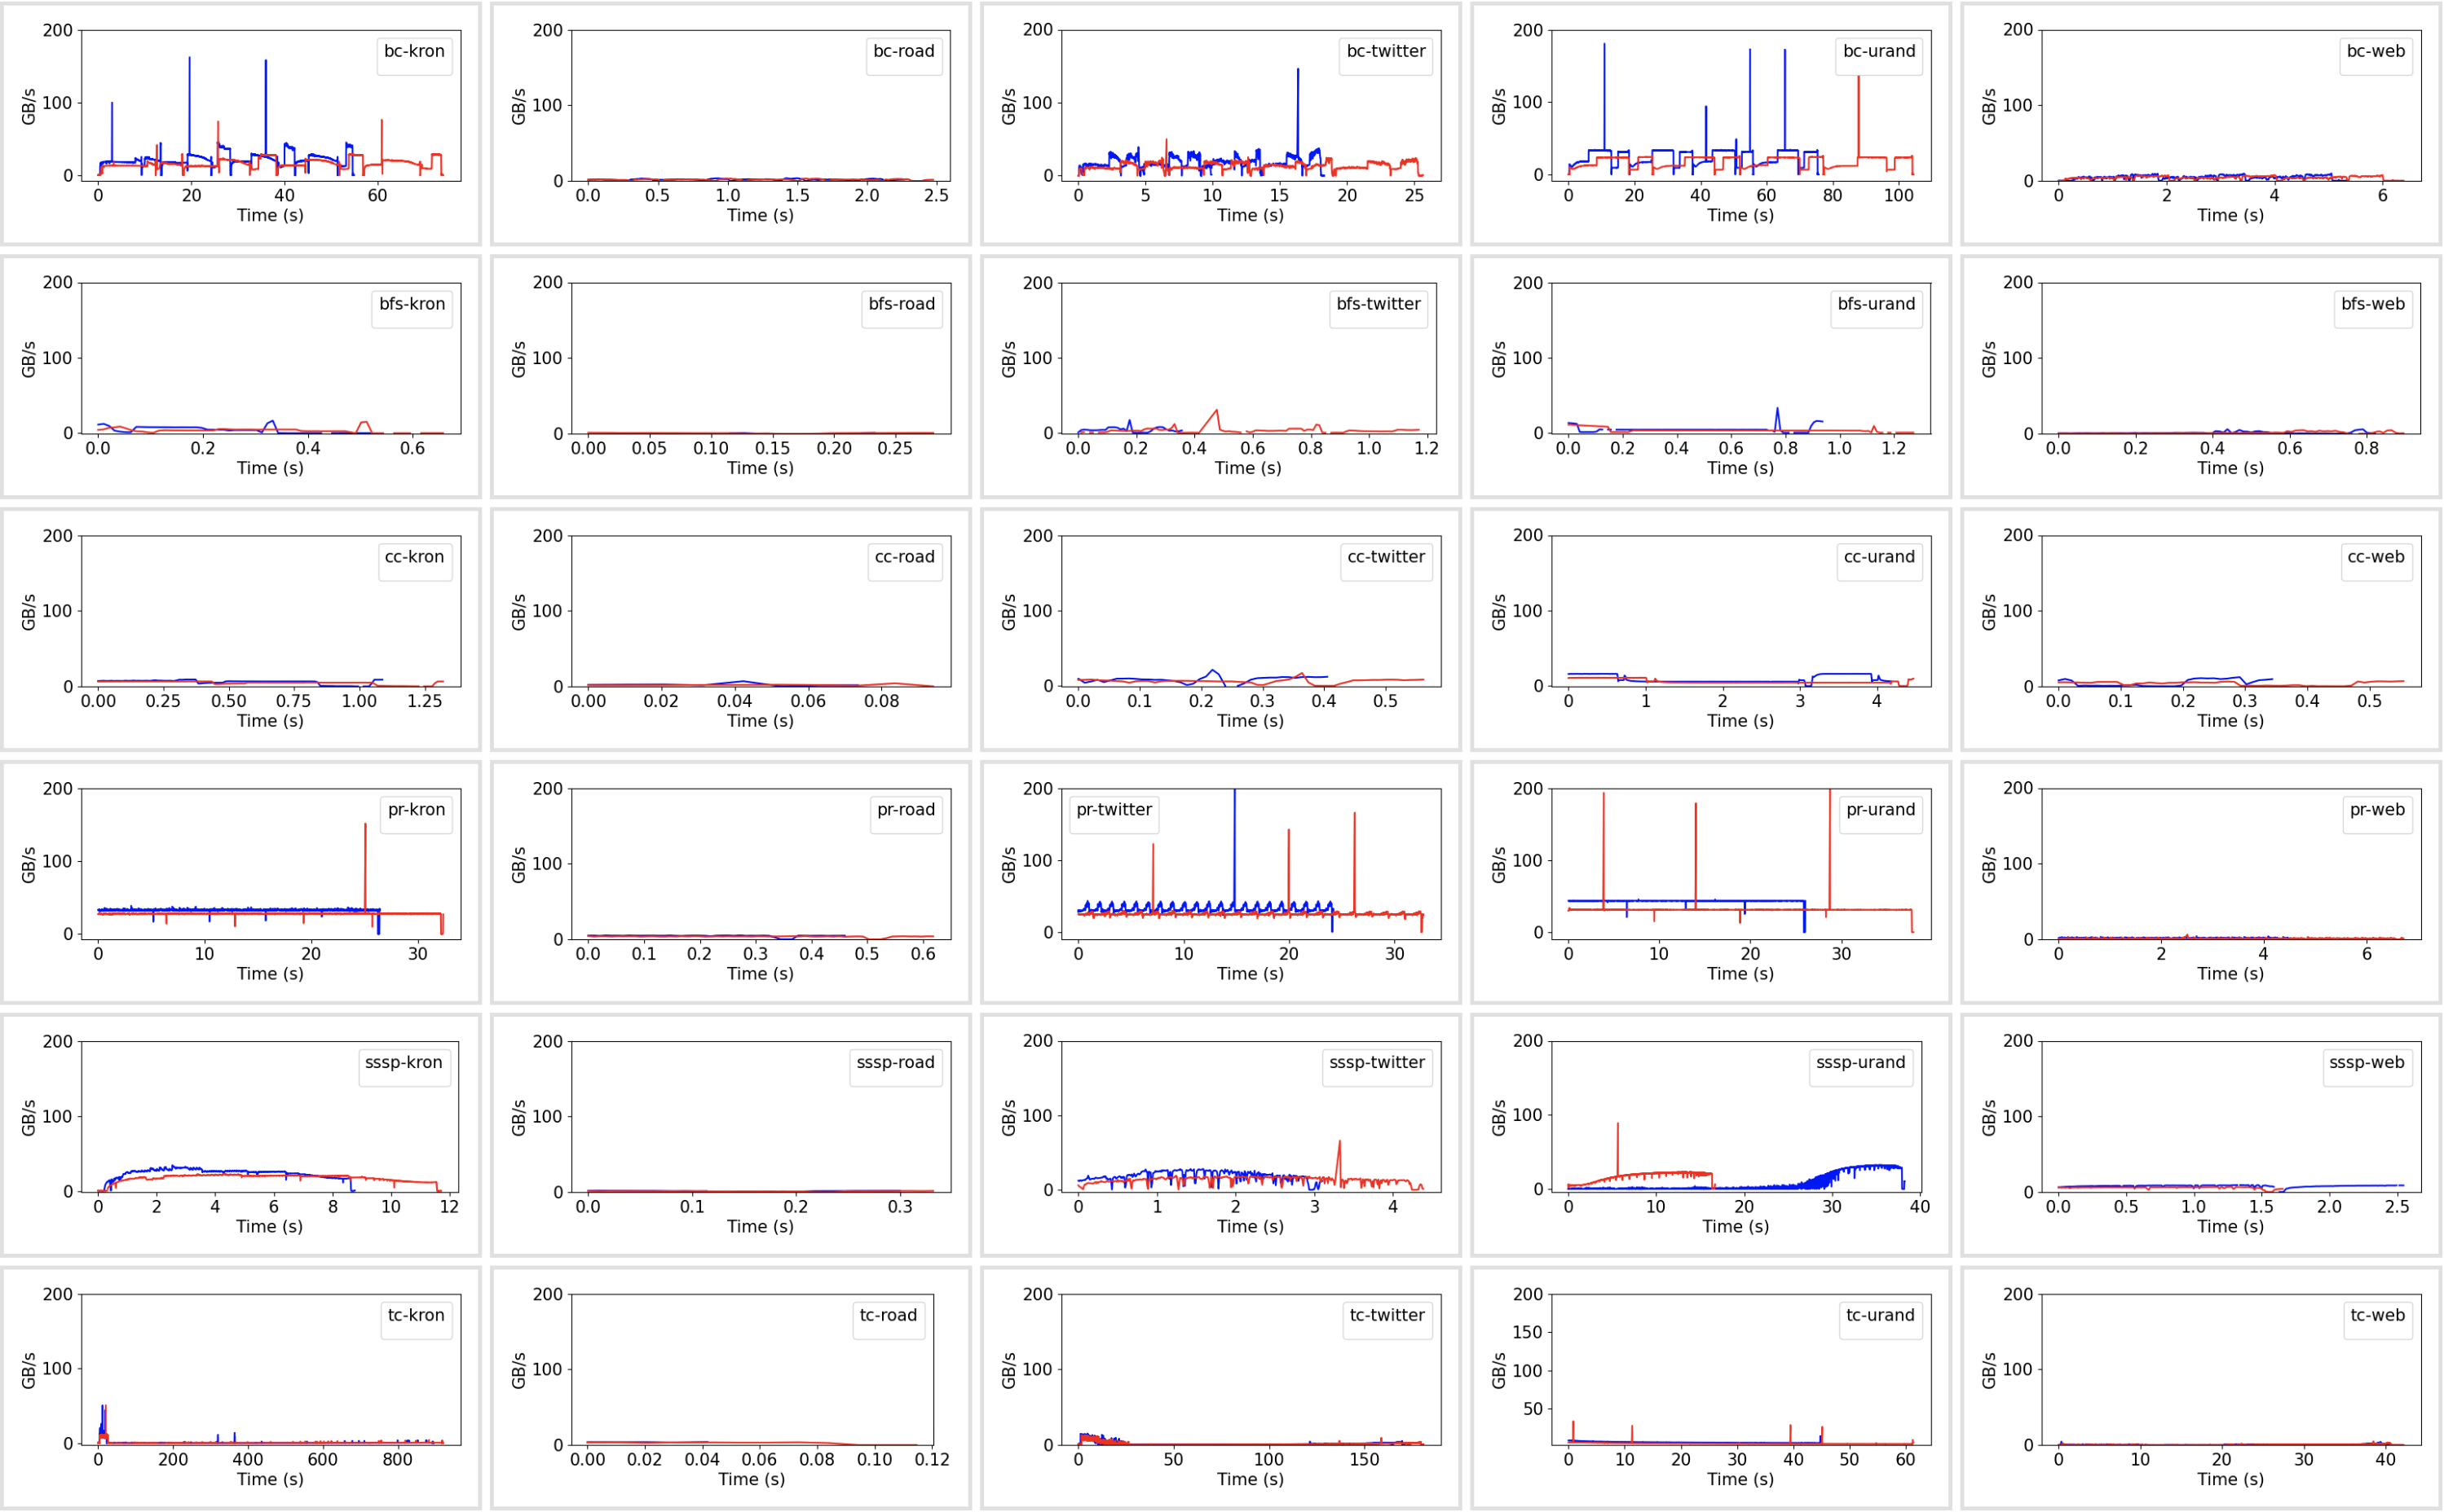
Memory Access Rate (Local vs. Remote)

